Slide 1

AI & Humanoid Robot
Created By
Nusrat Jahan Anka
All Rights reserved by Nusrat Jahan Anka (Nusrat Anka)

Slide 2
01
02
03
04
05
06
07
08
09
History of AI & Humanoids
Characteristics of Humanoids
Introduction
Correlation
Interfacing a humanoid Robot: Nao
Top AI based Humanoid Robots
Conclusion
Risk & Concern
References

Slide 3
Introduction
Thinking of Artificial Intelligence (AI), the key image that pops up in the head is that of a robot gliding around and giving mechanical replies. There are many forms of AI but humanoid robots are one of the most popular forms.
Correlation
The prime objective of AI for humanoids was for research purposes. They were utilized for research on how to create better prosthetics for humans. Modern-day humanoids are developed to carry out different human tasks and occupy different roles in the employment sector.

Slide 4
History of AI & Humanoids
In 1950 Computer scientist Alan Turing proposes a test for machine intelligence named TURING TEST. The time when AI started.
One of the earliest forms of humanoids was created in 1495 by Leonardo Da Vinci.
Characteristics of Humanoids
Self-maintenance
Autonomous learning
Avoiding harmful situations to people, property, & itself
Safe interacting with human beings & the environment

Slide 5
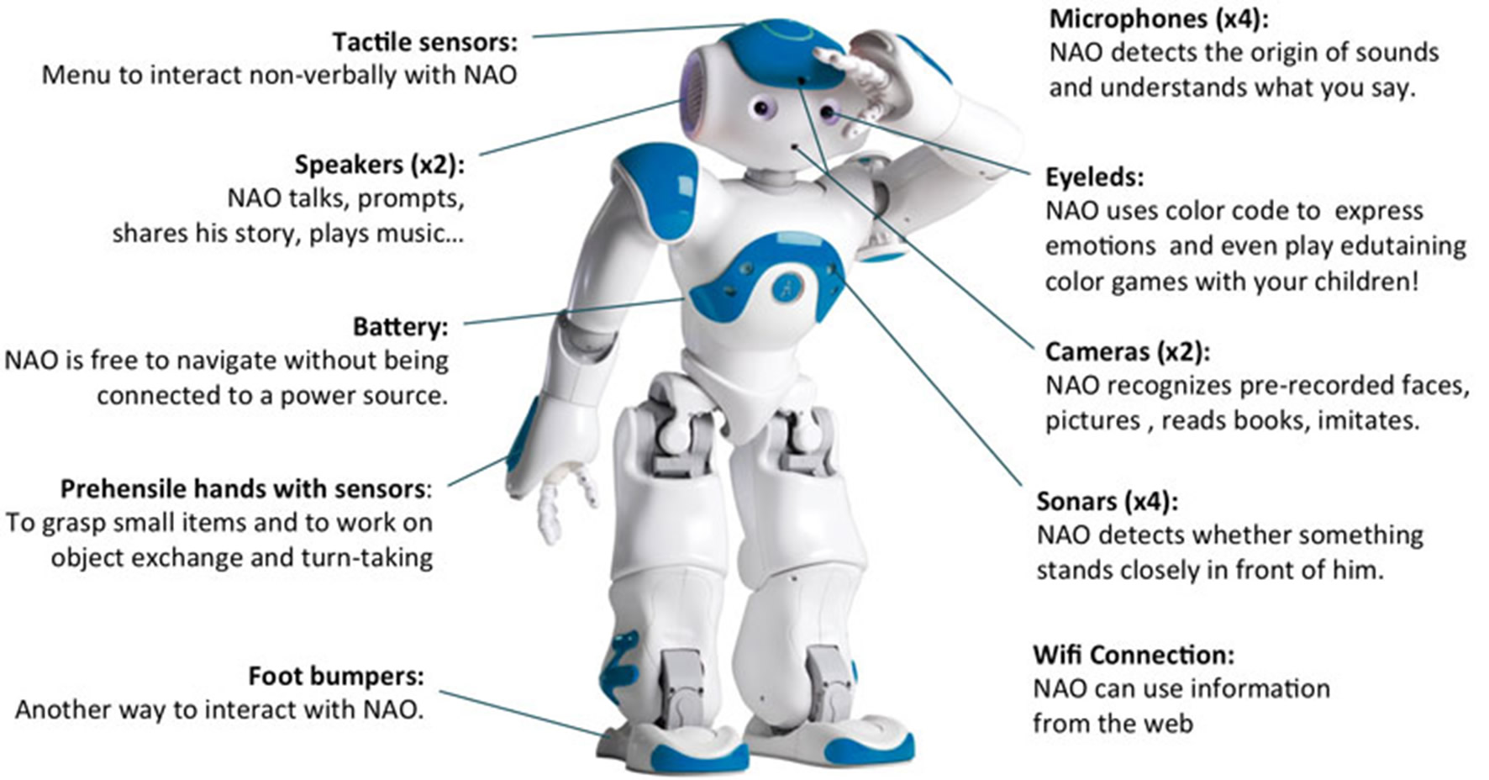
Interfacing a humanoid Robot: Nao

Slide 6
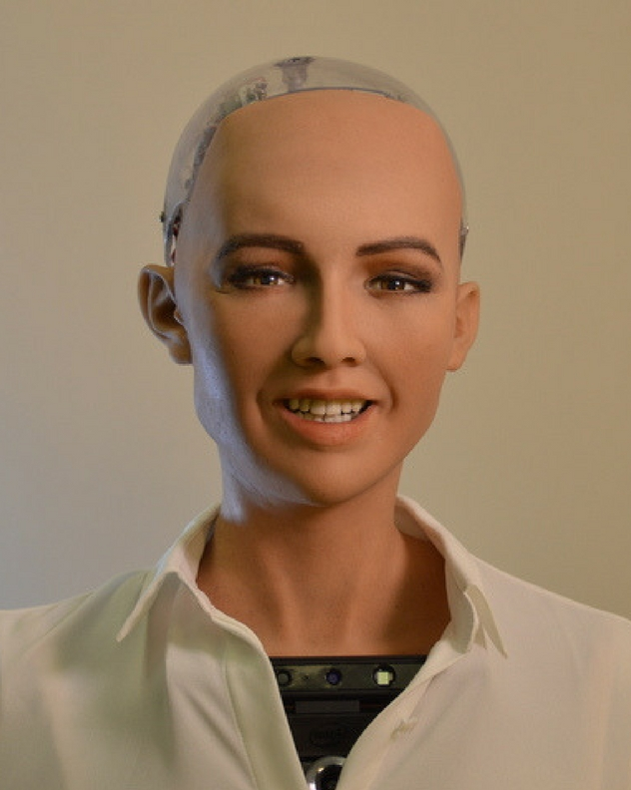
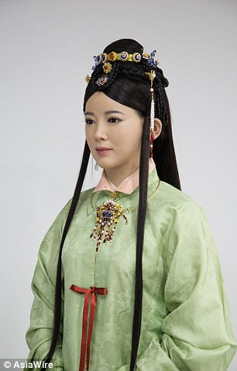
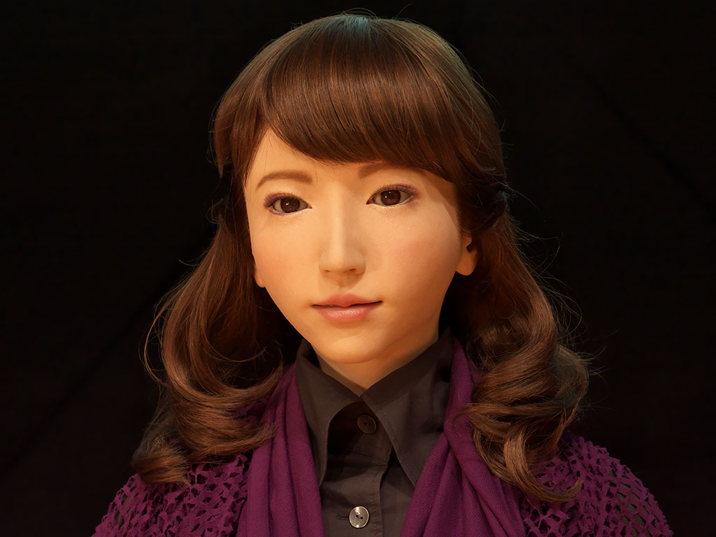
Top AI based Humanoid Robots
Sophia - Sophia was created by Hanson robotics and can carry out a wide range of human actions.
The Kodomoroid - She has been placed at the Museum of Emerging Science and Innovation in Tokyo where she currently works.
Jia Jia - This humanoid robot was worked on for three years by a team at the University of Science and Technology of China before its release.
Grace - A healthcare robot specializing in geriatric healthcare (medical care for older adults).
Erica - Created by Japanese scientists Hiroshi Ishiguro and Kohei Ogawa,
Ameca - Ameca would be the most realistic humanoid robot so far. Unveiled by Engineered Arts (a leading designer and manufacturer of humanoid entertainment robots) in December 2021

Slide 7
Risk & Concern
Physical harm
Job displacement
Privacy and security risks
Bias and discrimination
Social manipulation
Misalignment between our goals and the machine’s
Ethical concerns

Slide 8
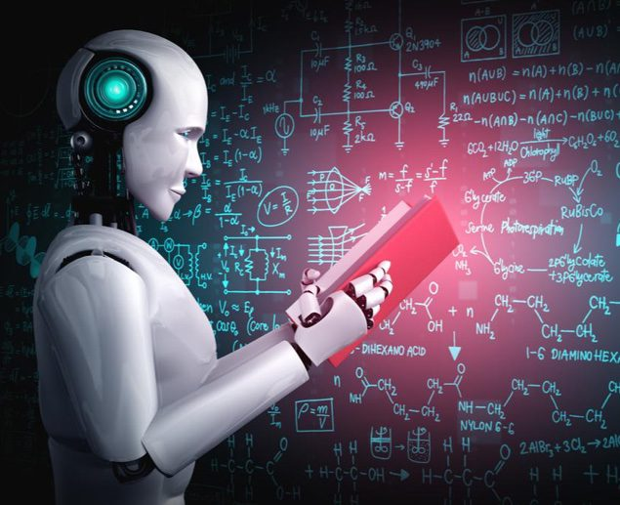
Conclusion
The use of AI in humanoid robots has the potential to revolutionize various industries and transform our daily lives. While there are many potential benefits, we must also consider the ethical implications and potential challenges that may arise.

Slide 9
References
https://www.forbes.com/sites/cognitiveworld/2019/02/25/artificial-intelligence-in-humanoid-robots/?sh=4a280ca424c7
https://www.onlinerobotics.com/relationship-robotics-ai.html
https://www.analyticsinsight.net/artificial-intelligence-and-humanoid-robots/
https://www.engineersgarage.com/humanoid-robots-an-overview/
https://digitalwellbeing.org/artificial-intelligence-timeline-infographic-from-eliza-to-tay-and-beyond/
https://www.wevolver.com/specs/nao.robot
https://www.jumpstartmag.com/top-5-ai-humanoid-robots-that-entered-our-world/
https://www.linkedin.com/pulse/ai-powered-humanoid-robots-could-dangerous-world-elazar-avramovits/
https://bernardmarr.com/is-artificial-intelligence-dangerous-6-ai-risks-everyone-should-know-about/

